Slide 1
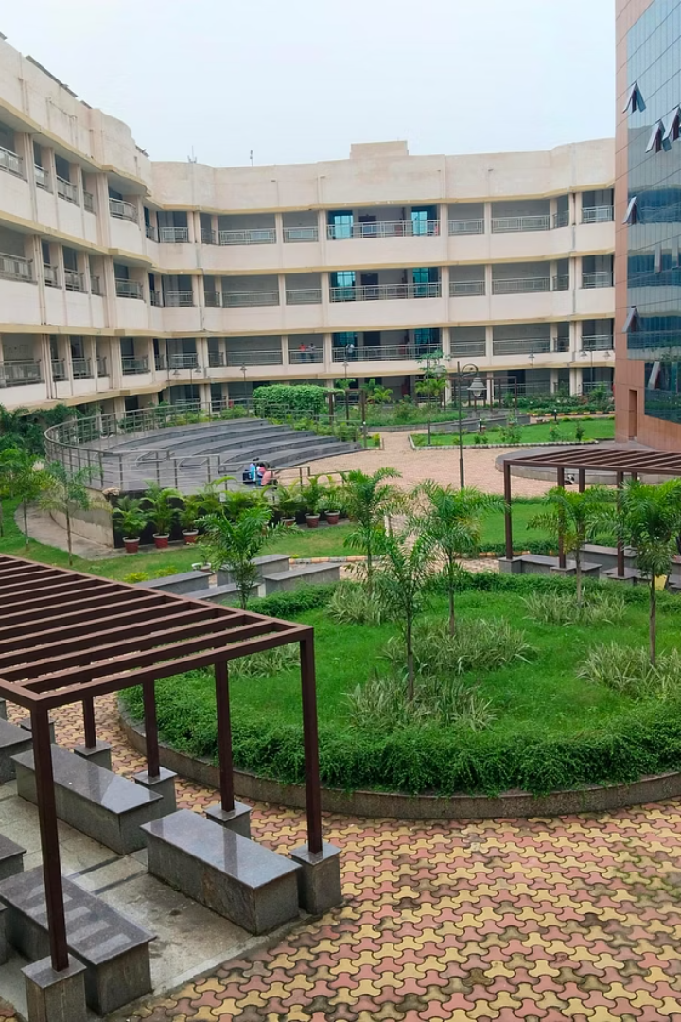
Pneumonia Detection Using Deep Learning
This project focuses on developing an AI-based system for detecting pneumonia from chest X-ray images using deep learning techniques. The study employs the ResNet-50 convolutional neural network architecture with transfer learning to achieve accurate and efficient classification. The dataset consists of 5,856 chest X-ray images, preprocessed and augmented to enhance model generalization. The goal is to provide a reliable tool to assist healthcare professionals in early pneumonia diagnosis, improving patient outcomes and reducing diagnostic delays.

Slide 2

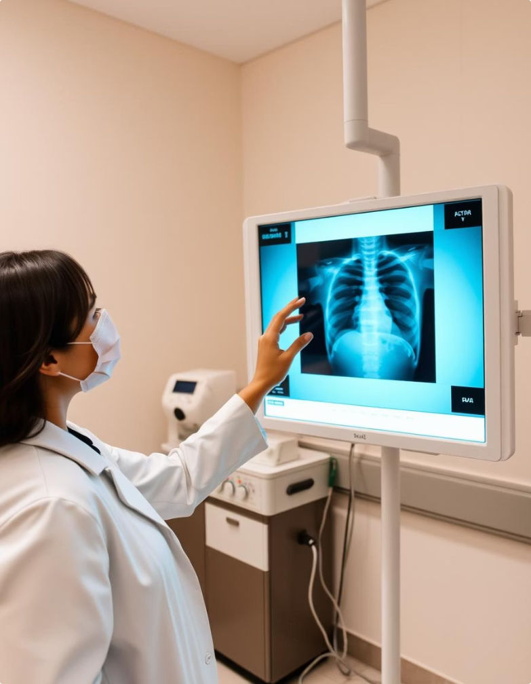
Introduction and Significance
About Pneumonia
Diagnostic Challenges
Pneumonia is a serious lung infection caused by bacteria, viruses, or fungi, leading to high morbidity and mortality worldwide, especially in children under five years.
Chest X-rays are the primary diagnostic tool but require expert interpretation, which can be time-consuming and prone to errors.
Role of AI
Deep learning models, especially CNNs like ResNet-50, offer automated, reliable, and faster pneumonia detection, reducing diagnostic variability and delays.

Slide 3
Literature Review Highlights
Previous Approaches
Key Insights
Cough sound analysis with logistic regression achieved 75% specificity and 94% sensitivity.
Transfer learning enhances model performance and reduces training time.
VGG-based CNN models reached up to 96% accuracy using chest X-rays.
Large, diverse datasets improve generalization but require preprocessing.
MobileNet and ResNet variants showed accuracies between 93% and 99% on various datasets.
Residual networks like ResNet mitigate vanishing gradients, enabling deeper models.

Slide 4

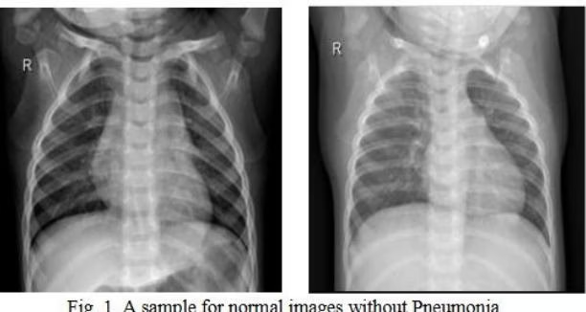
Dataset and Preprocessing
Dataset Overview
Preprocessing Steps
5,856 chest X-ray images categorized as Normal (1,583) and Pneumonia (4,273), split into training (80%), validation (10%), and test (10%) sets.
Cleaning unreadable images, resizing to 224×224 pixels, normalization, and data augmentation including rotation, flipping, zooming, and shear transformations.
Purpose
Standardizing and enriching the dataset to improve model training, generalization, and reduce overfitting.

Slide 5

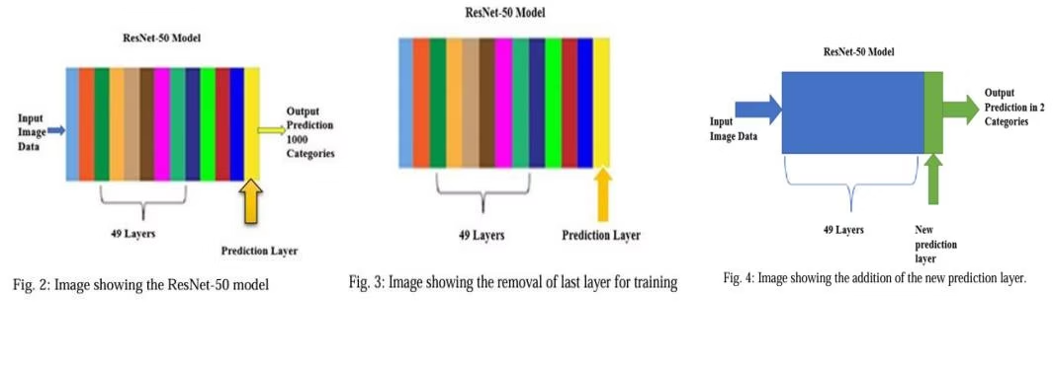



Deep Learning and ResNet-50 Architecture
Deep Learning
ResNet-50
Transfer Learning
Uses multiple layers of nonlinear processing units for feature extraction and classification, excelling in image recognition tasks.
A 50-layer CNN with residual connections that prevent vanishing gradients, enabling effective training of deep networks.
Utilizes pretrained ImageNet weights, fine-tuning the model for pneumonia detection to reduce training time and improve accuracy.

Slide 6
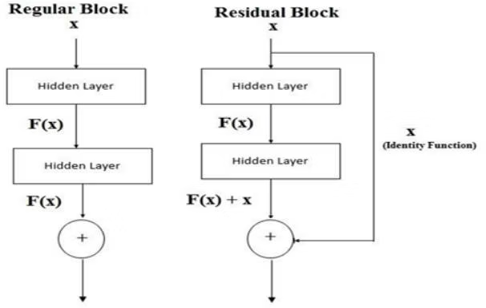
Model Architecture and Layers
Input and Base Model
Key Layers
Final Layers
Input images resized to 224×224×3. Base ResNet-50 pretrained on ImageNet provides convolutional and residual layers.
Convolutional layers extract features.
Fully connected dense layer with 1,024 units and ReLU activation, dropout layer (rate 0.5) to prevent overfitting, and sigmoid output layer for binary classification.
Max pooling reduces spatial dimensions.
Residual blocks enable deeper learning.
Global average pooling summarizes features.

Slide 7

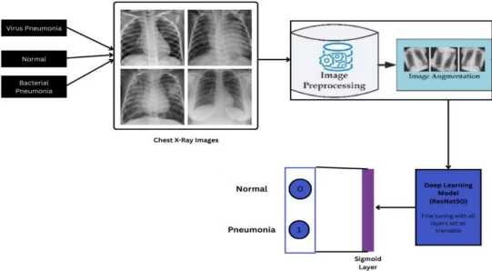
Training Setup and Hyperparameters
Training Details
Data Augmentation
Hardware
Model trained for 20 epochs with batch size 32 using Adam optimizer and binary cross-entropy loss function.
Applied rotation, zoom, shear, and horizontal flips on training data to improve robustness.
Training performed on Intel i5/i7 processors with 8/16 GB RAM; GPU acceleration recommended for faster training.

Slide 8

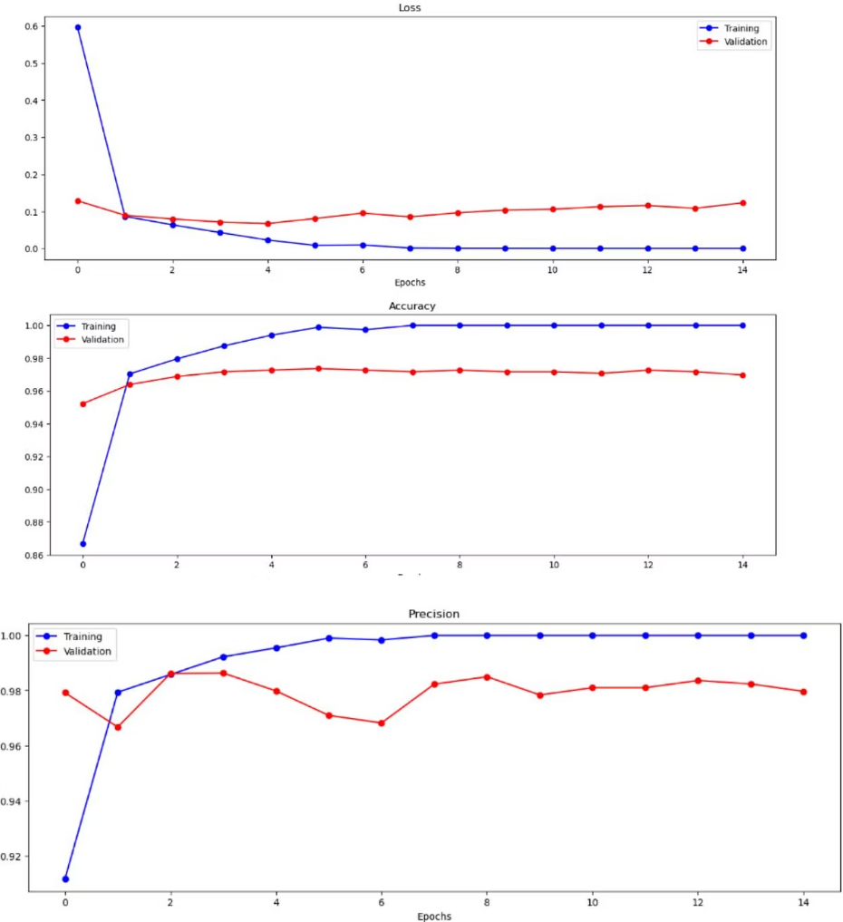
Experimental Results and Metrics
1
Accuracy
Achieved 97.3% accuracy on the test set after 20 epochs.
2
Precision & Recall
High precision (98.0%) and recall (98.2%) indicate reliable pneumonia detection with minimal false positives and negatives.
3
F1-Score
F1-measure of 0.9806 confirms balanced performance between precision and recall.
4
Loss
Low loss value of 0.065 reflects effective model training and convergence.

Slide 9
Comparative Analysis and Discussion
Comparison with Literature
Model Advantages
Challenges
The proposed ResNet-50 model outperforms other architectures like VGG16, MobileNet, and custom models with the highest accuracy of 97.3%.
Fast and robust diagnosis suitable for clinics without radiologists.
Hardware limitations without GPU slowed training; resizing images was necessary to standardize inputs.
Transfer learning reduces training time and overfitting.
Effective handling of data imbalance and image variability.

Slide 10

Conclusion and Future Work
Conclusion
Future Directions
The study validates the effectiveness of ResNet-50 with transfer learning for pneumonia detection, achieving 97.2% accuracy and demonstrating potential for clinical application.
Plans include extending classification to bacterial vs viral pneumonia, multi-label detection of lung diseases, real-time deployment, and explainability via Grad-CAM for clinician trust.

